Slide 1
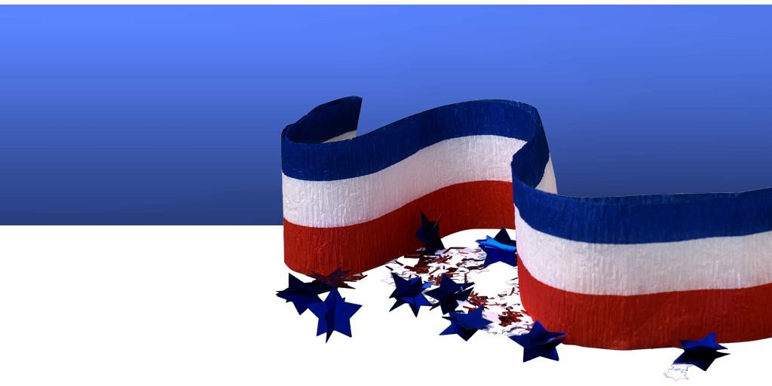
FINAL
OFFICIAL RESULTS
Thomas County General Election Results November 3, 2020

Slide 2
National & State Offices President/Vice President
Biden/Harris
625
Trump/Pence
3,130
Jorgensen/Cohen
55

Slide 3
National & State Offices United State Senate
Barbara Bollier
688
Roger Marshall
2,965
Jason Buckley
146

Slide 4
National & State Offices US House of Rep 1st District
Kali Barnett
599
Tracy Mann
3,131

Slide 5
National & State Offices Kansas State Senate 40th
Larry Joseph Dreiling
536
Richard Billinger
3,247

Slide 6
National & State Offices Kansas House of Rep 118th
Jim Minnix
535

Slide 7
National & State Offices Kansas House of Rep 120th
Adam Smith
2,938

Slide 8
National & State Offices District Judge 15th Dis 1st Div
Kevin Berens
3,524

Slide 9
National & State Offices District Judge 15th Dis 2nd Div
Scott Showalter
3,459

Slide 10
National & State Offices District Magistrate Judge 15th Dis 5th Position
Richard Ress
3,556

Slide 11
County Comminsioner
District #2
Brian L. Luedke
1,221

Slide 12
County Comminsioner
District #3
Mike Baughn (REP)
937
Dale Vap (DEM)
257

Slide 13
Thomas County Clerk
Shelly Harms
3,510

Slide 14
County Treasurer
Layn M. Bruggeman
3,587

Slide 15
County Register of Deeds
Lora L. Volk
3,590

Slide 16
Thomas County Attorney
Christoher A. Rohr
3,415
Rachel Lamm
85

Slide 17
County Sheriff
Tom Nickols
3,498

Slide 18
Barrett Township Trustee
& Treasurer
Shea Baird (Trustee)
42
Lyman Bear
11
Vickie Oard (Treasurer)
53

Slide 19
Kingery Township Trustee
& Treasurer
James Weed (Trustee)
43
Ray T. Duncan (Jack) (Treasurer 46

Slide 20
Menlo Township Trustee &
Treasurer
Adam Ryan (Trustee)
31
Susan Guill (Treasurer) 30

Slide 21
North Randall Township Trustee & Treasurer
Lonnie Wilson (Trustee) 32
Jason C. Sowers (Treasurer) 34

Slide 22
Morgan Township Trustee
& Treasurer
Larry J. Heier (Trustee)
324
John J. Cranston(Treasurer)
352

Slide 23
Rovohl Township Trustee
& Treasurer
Stephen Shull (Trustee) 78
Rocky Urban
9
David Pabst (Treasurer) 72
John Schroeder
20

Slide 24
South Randall Township Trustee & Treasurer
James G. Fellhoelter (Trustee) 131
Bob Ottley (Treasurer)
8

Slide 25
West Hale Township Trustee & Treasurer
Ken Kammer (Trustee) 167
Willard Crumrine (Treasurer) 166

Slide 26
East Hale Township Trustee & Treasurer
Wade McCoy (Trustee) 68
Scott Collett (Treasurer)
4

Slide 27
Lacey Township Trustee & Treasurer
Jonathan Higerd (Trustee)
62
Vernon Roemer (Treasurer)
66

Slide 28
Smith Township Trustee & Treasurer
Ben Hoeting (Trustee)
9
Mark Anderson (Treasurer)
88

Slide 29
Summers Township Trustee & Treasurer
Lynn Goossen (Trustee)
107
Frank Jurek (Treasurer)
109

Slide 30
Wendell Township Trustee & Treasurer
Chad Focke (Trustee)
33
Darrel Dible (Treasurer)
35

Slide 31
Supreme Court For Justice/Court of Appeals for Judge
Shall Eric S. Rosen, Topeka, Position No. 4, Kansas Supreme Court, be retained in office?
Yes
2,354
No
1,084

Slide 32
Supreme Court For Justice/Court of Appeals for Judge
Shall Sarah E. Warner, Lenexa, Position No. 4, Kansas Court of Appeals, be retained in office?
Yes
2,719
No
703

Slide 33
Supreme Court For Justice/Court of Appeals for Judge
Shall David E. Bruns, Olathe, Position No. 6, Kansas Court of Appeals, be retained in office?
Yes
2,748
No
644

Slide 34
Supreme Court For Justice/Court of Appeals for Judge
Shall G. Gordon Atcheson, Overland Park, Position No. 8, Kansas Court of Appeals, be retained in office?
Yes
2,300
No
1,088

Slide 35
Supreme Court For Justice/Court of Appeals for Judge
Shall Karen M. Arnold-Burger, Overland Park, Position No. 9, Kansas Court of Appeals, be retained in office?
Yes
2,280
No
1,111

Slide 36
Supreme Court For Justice/Court of Appeals for Judge
Shall Kathryn Gardner, Topeka, Position No. 14, Kansas Court of Appeals, be retained in office?
Yes
2,751
No
648

